Slide 1
ENTERPRISE SERVER MONITORING & RELIABILITY ANALYTICS PLATFORM -------- Data engineering use case submission
Elluri Sri Lakshmi
Data Engineer Candidate NeoStats Hiring Drive – 2026

Slide 2
BUSINESS CONTEXT & PROBLEM STATEMENT
Modern enterprise infrastructure generates high-volume operational telemetry
Raw monitoring logs are not structured for analytical consumption Lack of curated datasets limits performance visibility and proactive decision-making
Organizations require unified monitoring frameworks to track utilization, availability, and system health
Engineering challenge: convert operational logs into scalable analytical monitoring system
Objective: enable data-driven infrastructure reliability assessment

Slide 3
SOLUTION OVERVIEW
Designed an end-to-end data engineering pipeline for infrastructure analytics
Implemented modular architecture separating ingestion, transformation, and reporting layers
Simulated enterprise data lake environment using structured storage design
Built Python-based ETL workflow to standardize and enrich operational logs
Engineered performance indicators to support infrastructure intelligence
Delivered interactive monitoring dashboards for operational visibility

Slide 4
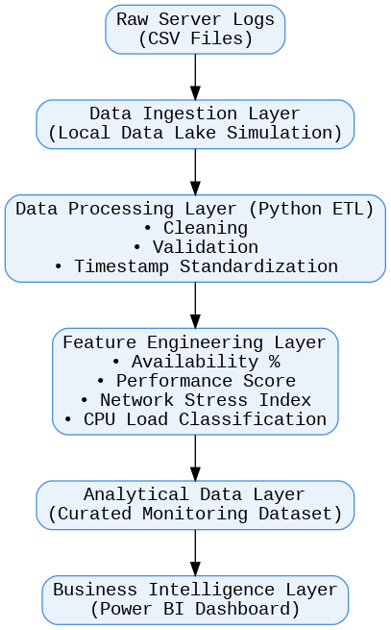
END-TO-END DATA PIPELINE ARCHITECTURE
Transforms raw telemetry into curated analytical datasets for performance monitoring and reliability risk detection
Layered architecture ensures modular data processing
Feature engineering enhances infrastructure observability
Curated dataset improves reporting performance
Architecture supports scalability and future real-time integration
Server Monitoring Pipeline Architecture

Slide 5
PIPELINE ARCHITECTURE
Raw server logs ingested into staging layer
Data validation and cleansing performed using transformation scripts
Temporal normalization applied for time-series consistency
Feature engineering layer created analytical performance indicators
Aggregation layer produced semantic datasets for reporting
Business intelligence layer enabled interactive monitoring workflows
Architecture supports scalability for real-time and cloud integration

Slide 6
DATA ENGINEERING METHODOLOGY
Missing infrastructure metrics handled using statistical imputation
Timestamp inconsistencies resolved to ensure chronological accuracy
Derived metrics engineered to improve interpretability of system behaviour
Network stress index developed from traffic utilization patterns
Availability ratio calculated to quantify operational stability
CPU workload categorized to identify performance pressure zones
Designed curated analytical dataset aligned with semantic modelling principles
Designed layered transformation pipeline for analytical data readiness

Slide 7
ANALYTICAL MONITORING DESIGN
Executive dashboard provides consolidated system performance overview
Resource utilization analysis highlights regional infrastructure pressure
Distribution analysis identifies workload imbalance patterns Reliability monitoring tracks availability fluctuations and downtime risks
Risk indicator enables proactive identification of system instability
Multi-layer monitoring approach supports strategic and operational insights
KPI-driven monitoring aligned with infrastructure reliability metrics

Slide 8
KEY ENGINEERING CHALLENGES
Operational logs contained inconsistent temporal formats
Designing meaningful derived metrics required iterative validation
Ensuring analytical depth while maintaining dashboard clarity
Structuring pipeline to simulate enterprise architecture constraints
Balancing engineering rigor with assignment scope limitations
Maintaining modularity for potential future system scaling
Handling inconsistent timestamp formats in raw telemetry logs

Slide 9
OUTCOMES & IMPACT
Successfully transformed raw telemetry into decision-oriented analytical dataset
Enabled visibility into infrastructure utilization and performance trends
Provided structured framework for reliability monitoring
Demonstrated scalable pipeline design aligned with modern data engineering practices
Established foundation for predictive monitoring and automated alerting systems
Enabled structured infrastructure observability framework

Slide 10
FUTURE ENHANCEMENTS
Integration with real-time streaming ingestion frameworks
Migration to distributed cloud data warehouse architecture
Implementation of predictive reliability modeling using ML
Automated anomaly detection for infrastructure risk mitigation
Integration with real-time streaming data pipelines

